Slide 1
MATLAB
GPU Computing
Lee Jong Geon

Slide 2
MATLAB Computing
GPU Computing Process
MATLAB ➔ GPU Coder ➔ CUDA ➔ CUDA kernel parallelization
CUDA: A parallel computing technology from NVIDIA
Kernel: Code written for execution on the GPU
GPU Computing Case
Massively Parallel
Computationally intensive
CPU vs. GPU
Many loop (iteration) ➔ GPU (Multi-core)
Simple multiple ➔ CPU (Single-core)
Eom, J. GPU Computing with MATLAB. Video&Webinar, MathWork.

Slide 3
CPU&GPU Specification
CPU
 | Lab | Comp.
Model | Intel i5-3570 | Intel i7-5960X
Realsed | 2011 | 2014
Clock (GHz) | 3.40 | 3.00
Core # / Threds # | 4 / 4 | 8 / 16
GPU
 | Lab | Comp.
Model | NVIDIA GeForce GTX 560 | NVIDIA GeForce GTX 1080
Realsed | 2011 | 2016
Clock (MHz) | 1620-1900 | 1733
CUDA Core # | 336 | 2560
Memory | 1 GB GDDR5 | 8 GB GDDR5X

Slide 4
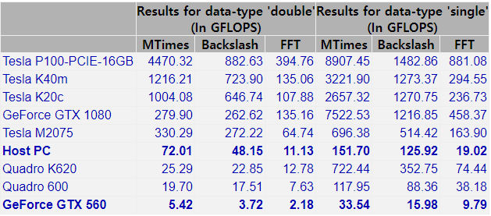
CPU&GPU Benchmark
GPU Bench Application: GPUBench
Made by MathWorks Parallel Computing Toolbox Team
Last Update: 13 Sep 2017
* FLOPS: Floating-point operations per second (FLOP/s)
15 digits
7 digits
(CPU, 4C/4T)
i7-5960X (CPU, 8C/16T) | 329.06 | 202.88 | 16.29 | 617.28 | 407.54 | 19.79

Slide 5
Workstation
Tesla P100-PCIE-16GB > $10,000
Tesla K40m > $2,000
Tesla K20c > $1,400
Double Precision: CPU computing, Single Precision: GPU computing
 | Model | Specification | Price (₩)
CPU | (Intel) Xeon Scalable Silver 4116 | 12C / 24T (2.1GHz) | 1,322,250
Mainboard | (ASUS) Z11PA-U12/10G-2S iBORA |  | 781,530
Memory | (SAMSUNG) DDR4 ECC/REG | 32GB*2+16GB*2 = 96GB | 1,228,040
Graphic Card | (ZOTAC) NVIDIA GeForce GTX 1080 | 2560 CUDA | 790,360
SSD | (SAMSUNG) 860 PRO | 256GB*2 | 303,400
Power | (Seasonic) SSR-850FX Full Modular | 80 PLUS Gold (eff. > 90%) | 150,680
Etc.(Case, Cooler, OS) |  | 4 Fan Case | 141,250
Total |  |  | 4,717,510

Slide 6
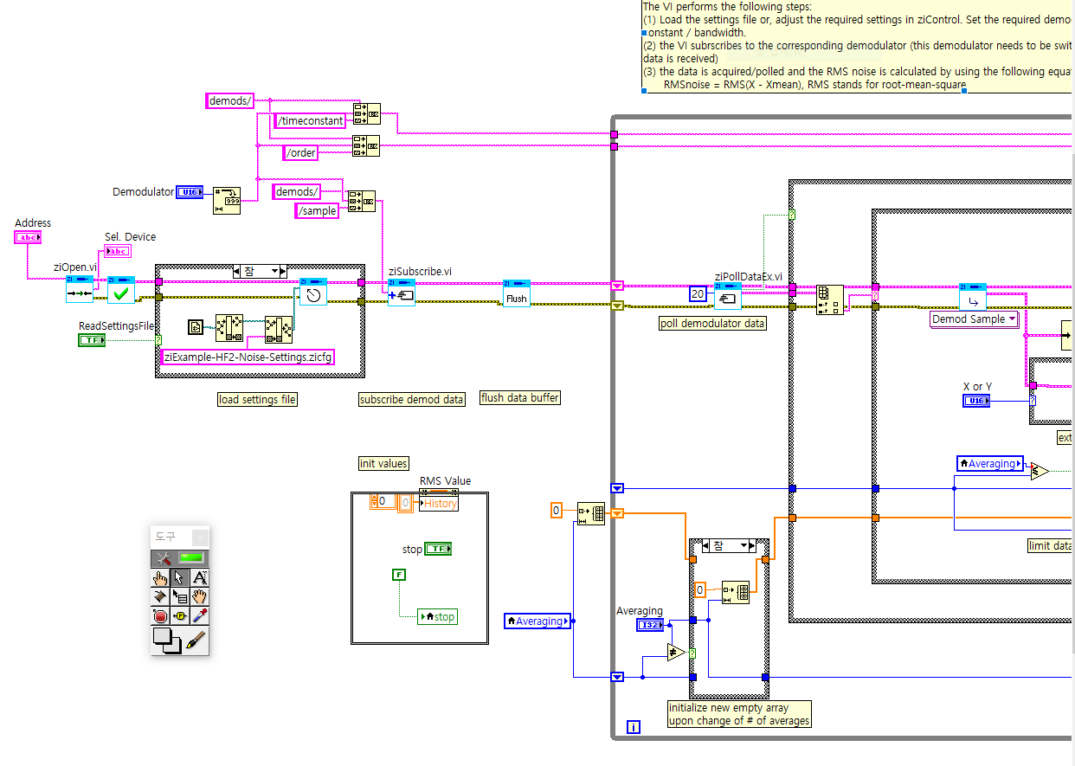
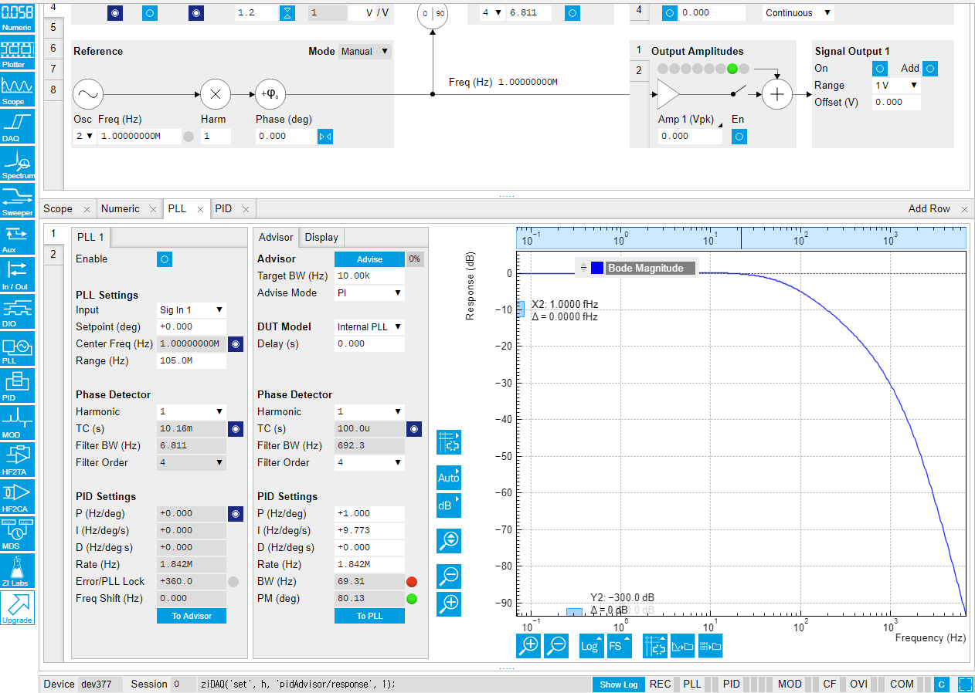
Week Plan
Zurich Lock-In Amplifier
LabVIEW Programming (Scope module, Noise measure example and etc.)
PLL, PID function

